Slide 2
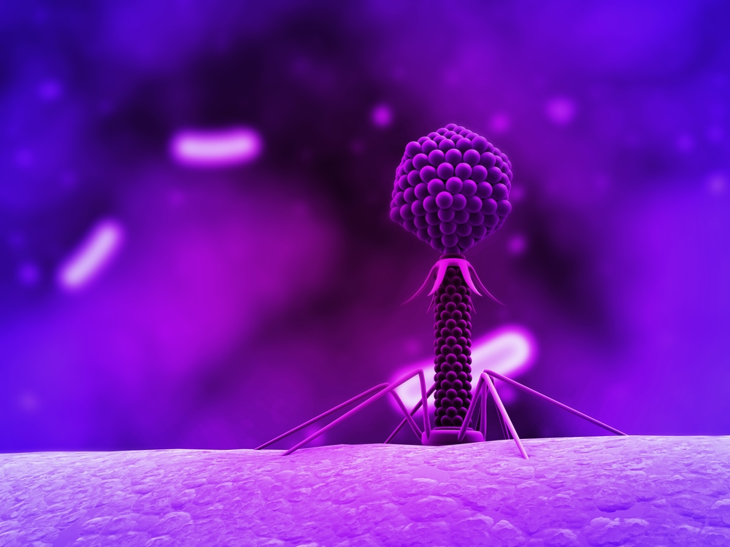
Characterizing Novel Mycobacteriophages
Arij Gabir & Scott Ryder
MCDB 1161: Phage Genomics Lab I

Slide 3
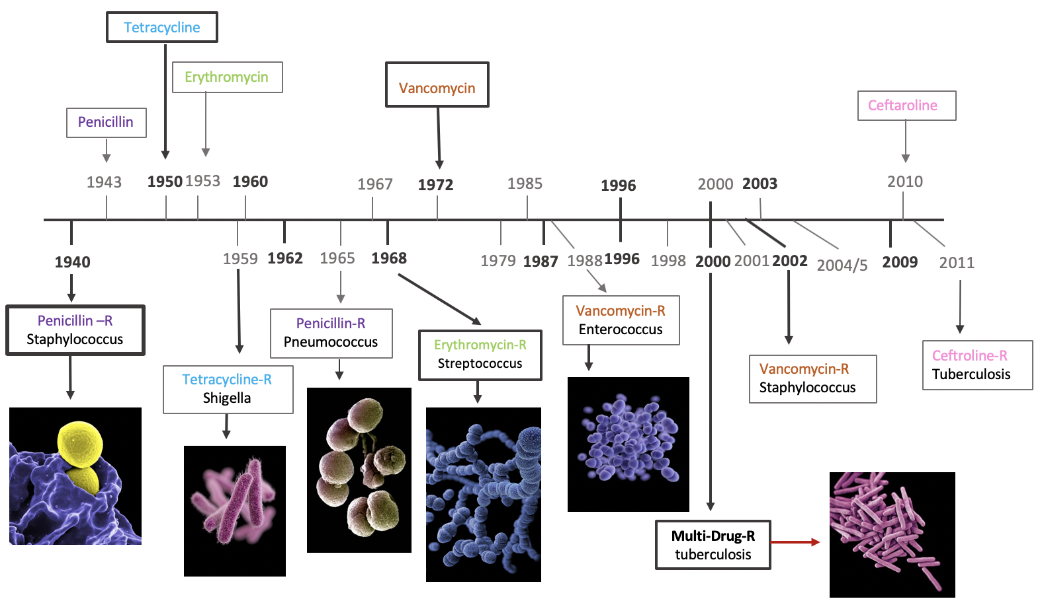
Years when Antibiotics were first introduced to the general population
Years when Antibiotic Resistance was first identified

Slide 4
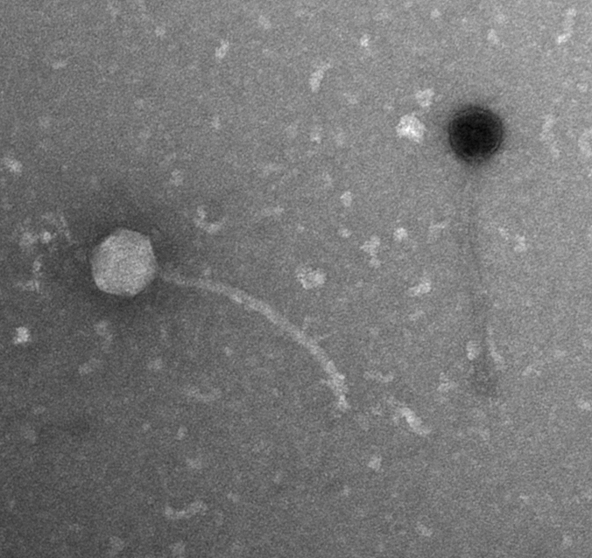
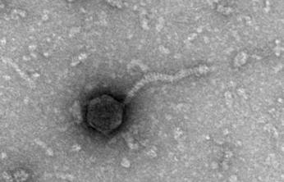
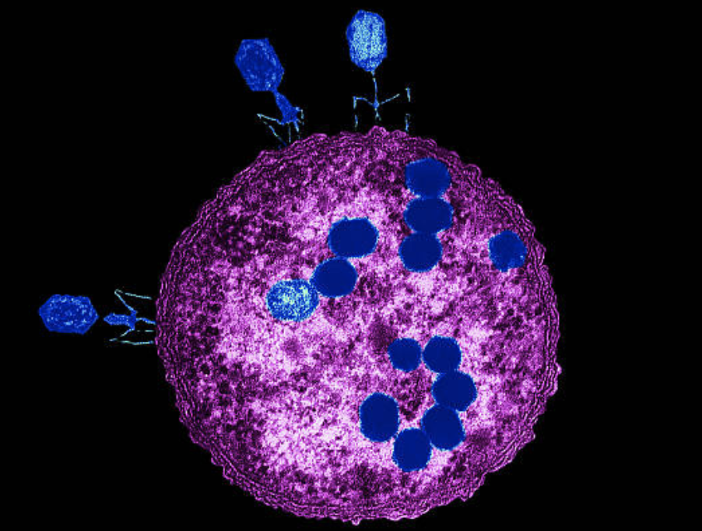
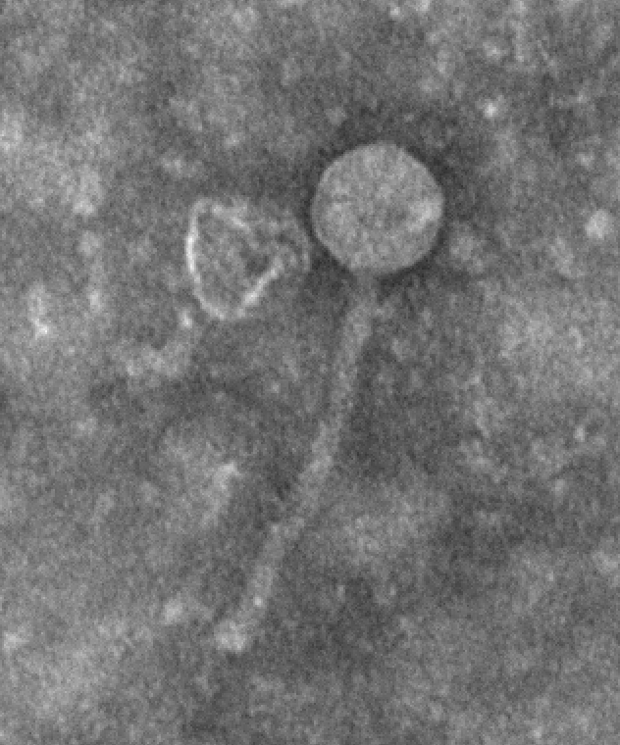
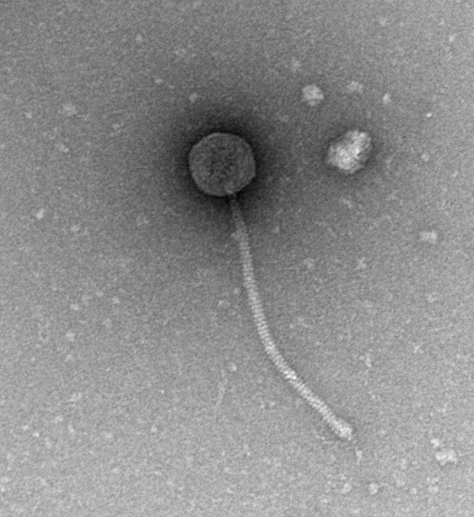
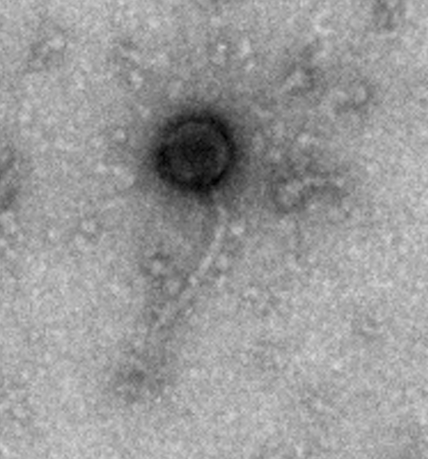
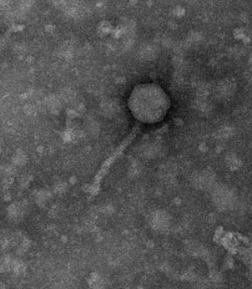
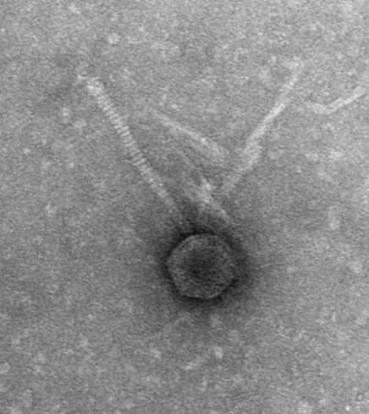
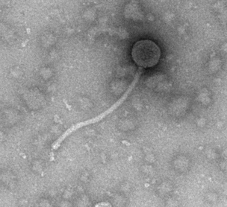
Bacteriophages are Viruses that Infect Bacteria

Slide 5
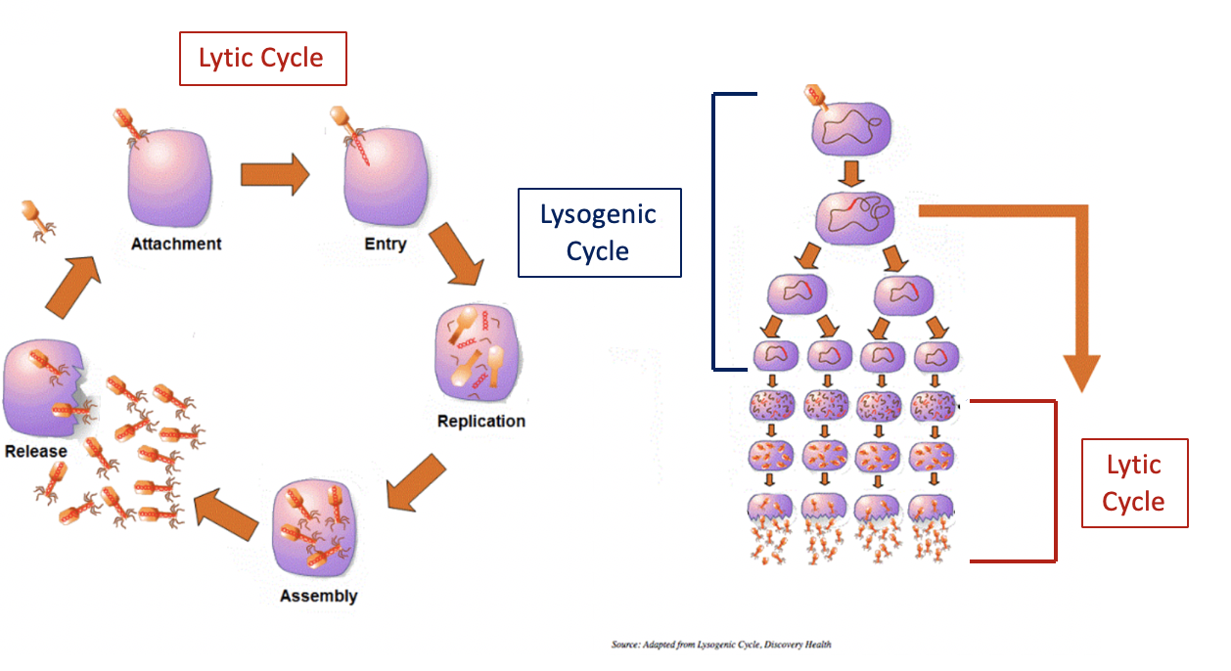
2 types of Bacteriophages:
Lytic
Phage
Temperate
Phage

Slide 6
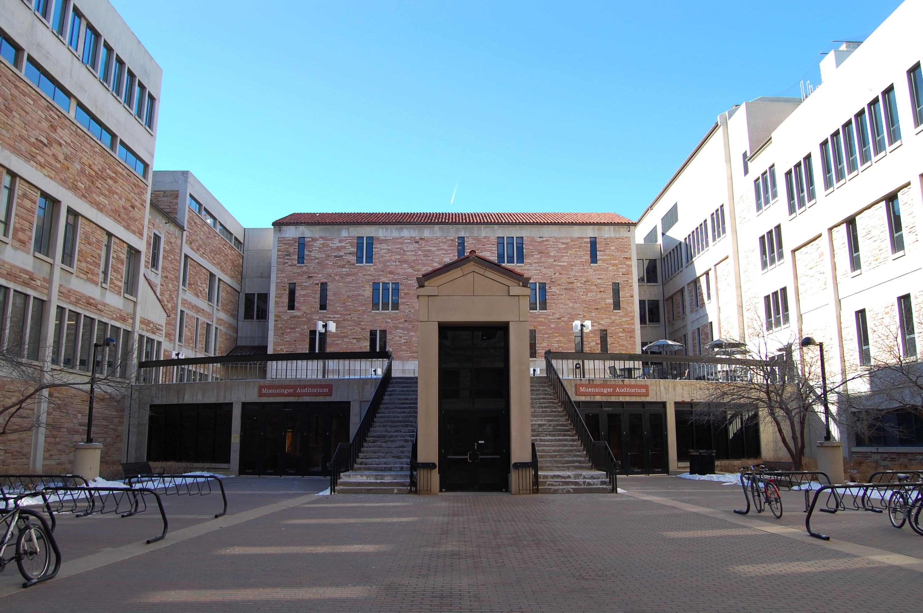
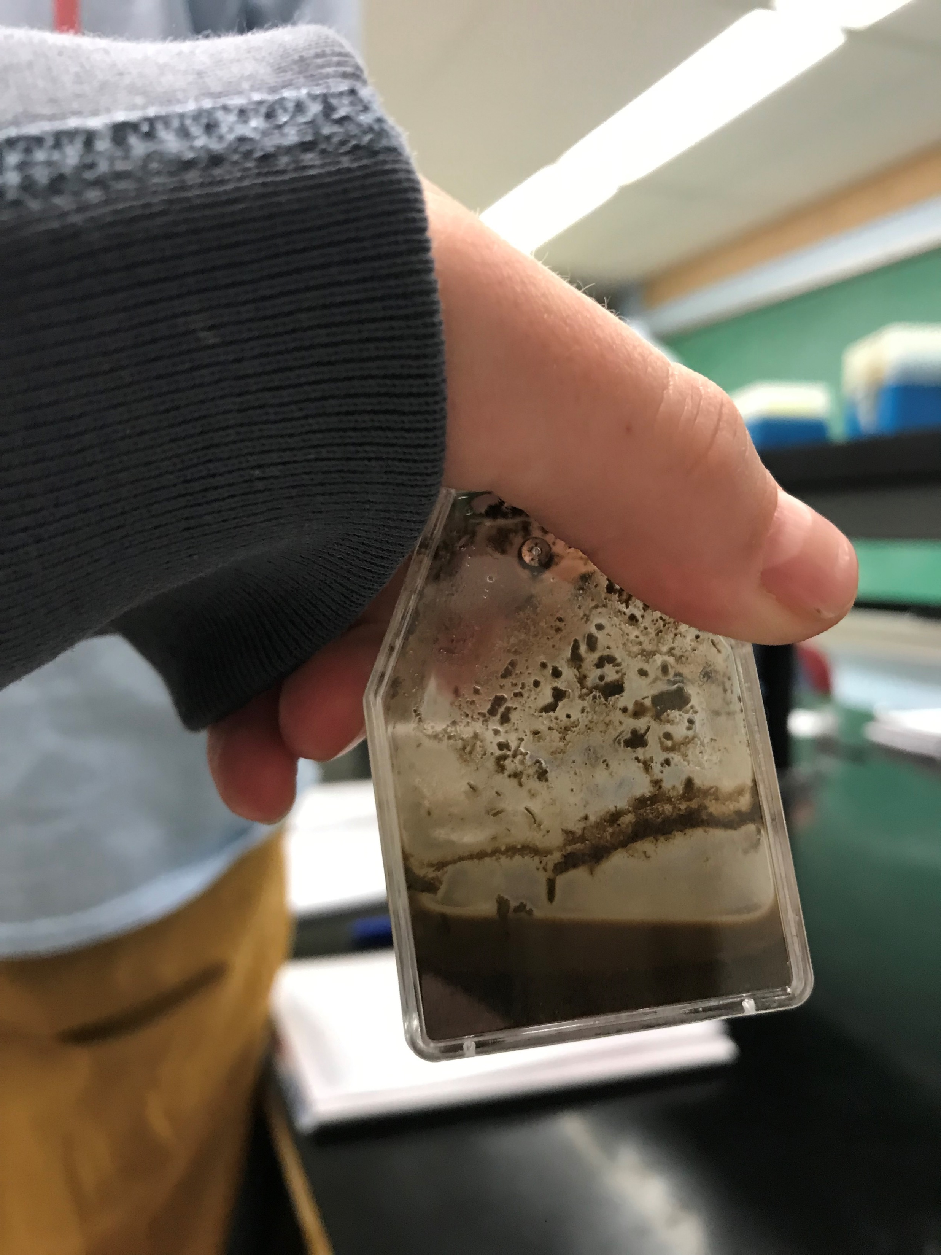
We Isolated a Bacteriophage from a Soil Sample
Phage are the most abundant entities on earth
Bacteriophage isolated using Mycobacterium smegmatis (M. smeg)
Notes:
As Arij said, the first goal of this lab is to isolate a phage
Obviously we can’t use TB to isolate a phage in this freshman level course, so we used a close non-pathogenic relative named M. smeg

Slide 7
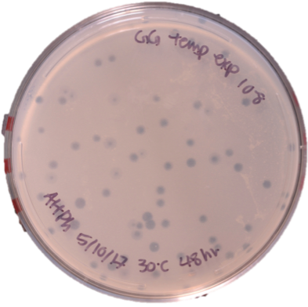
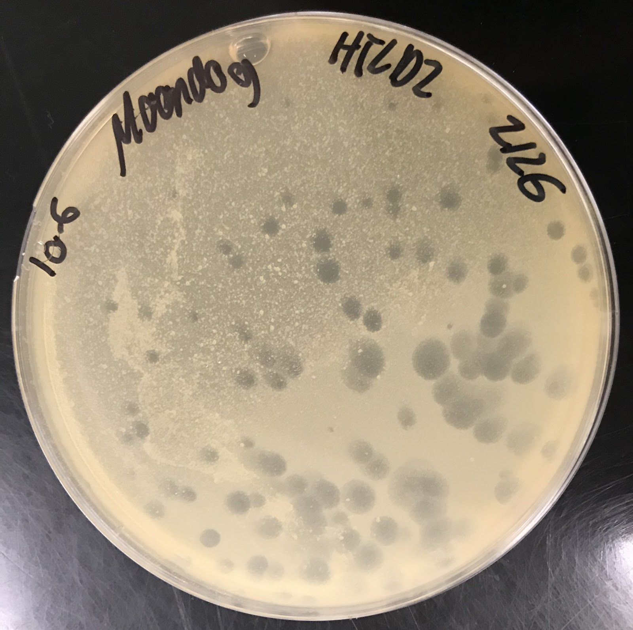
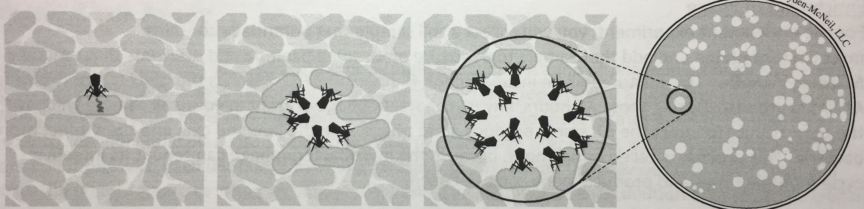
Lytic and Lysogenic Plaque Morphology of Phage
Altphacts (lytic)
Moondog (Temperate)
Notes:
Plaques help us to know if we found a phage
Once we isolate a phage, we begin to characterize it→plaque morphology helps us characterize phage

Slide 8
Morphotypes of Phage
Siphoviridae
Myoviridae
Notes:
We can characterize phages by how they look

Slide 9
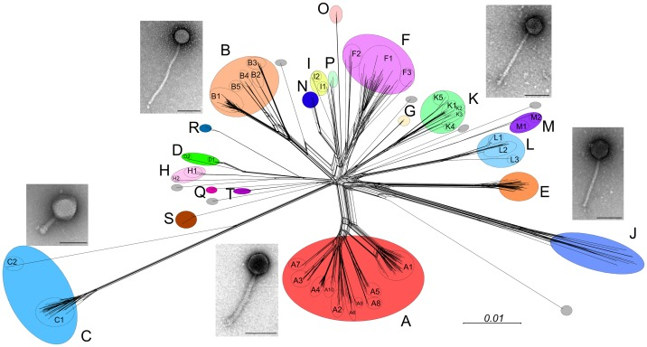
Phage are Categorized into Clusters based on genome similarity
Cluster = >50% genome similarity
Notes:
The final way we characterize our phage is by DNA analysis
-Cluster A and K phages have been shown to also be able to infect TB

Slide 10
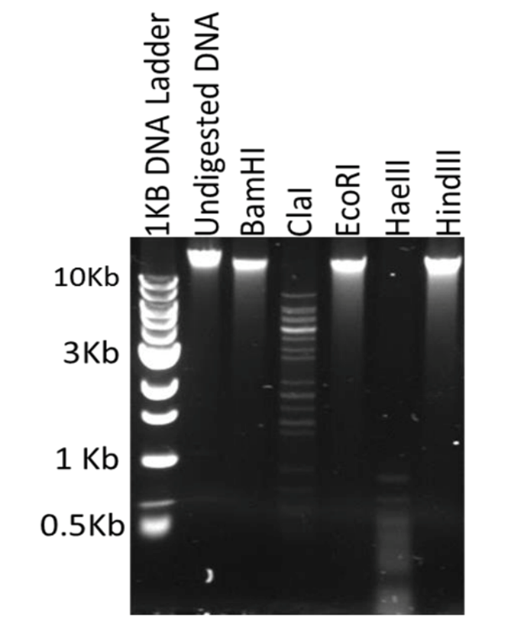
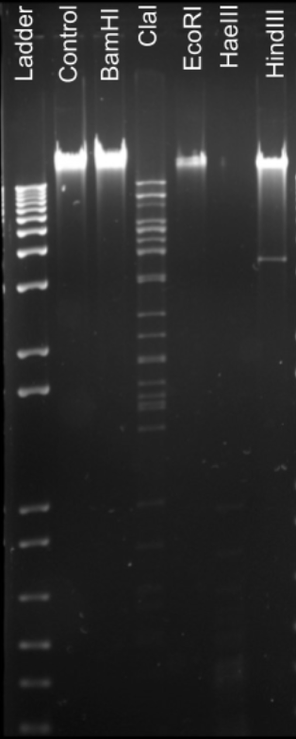
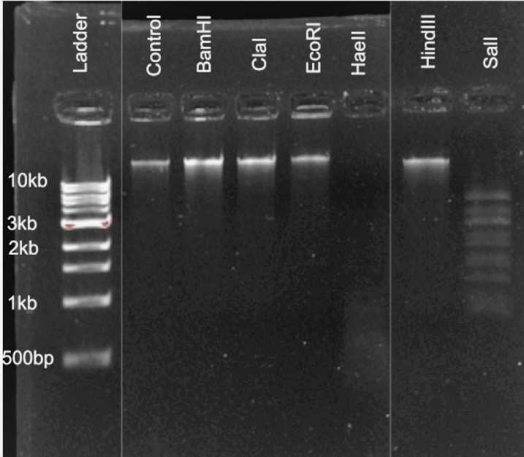
Using Restriction Digestion Analysis to Hypothesize Cluster
B1 Cluster phage
B1 Cluster phage
A4 Cluster phage
Notes:
Say what Restriction Enzymes are—Restriction Enzymes cut DNA at specific sites
Because of this, we can use restriction digestion to analyze our DNA
The pattern that results is similar to members of the same cluster and thus we can use it to hypothesize the cluster that our phage belongs to
We are using restriction enzymes to digest phage DNA and match the patterns with other familial phage
Phages in the same cluster have similar patterns

Slide 11
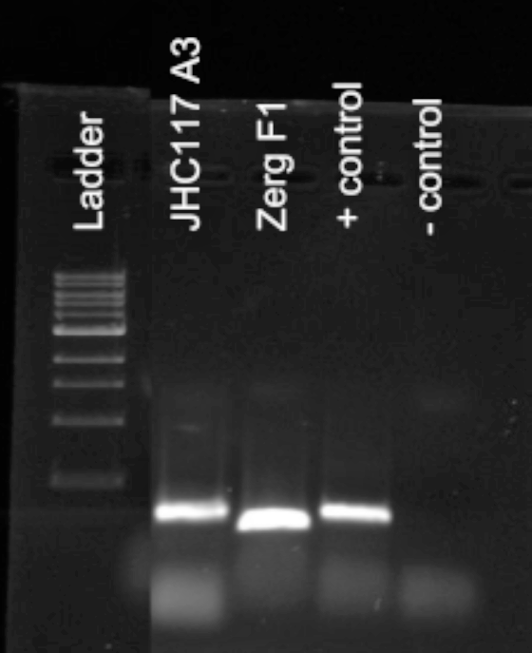
PCR Used to Confirm Cluster Hypothesis
Amplified DNA
PCR primers

Slide 12
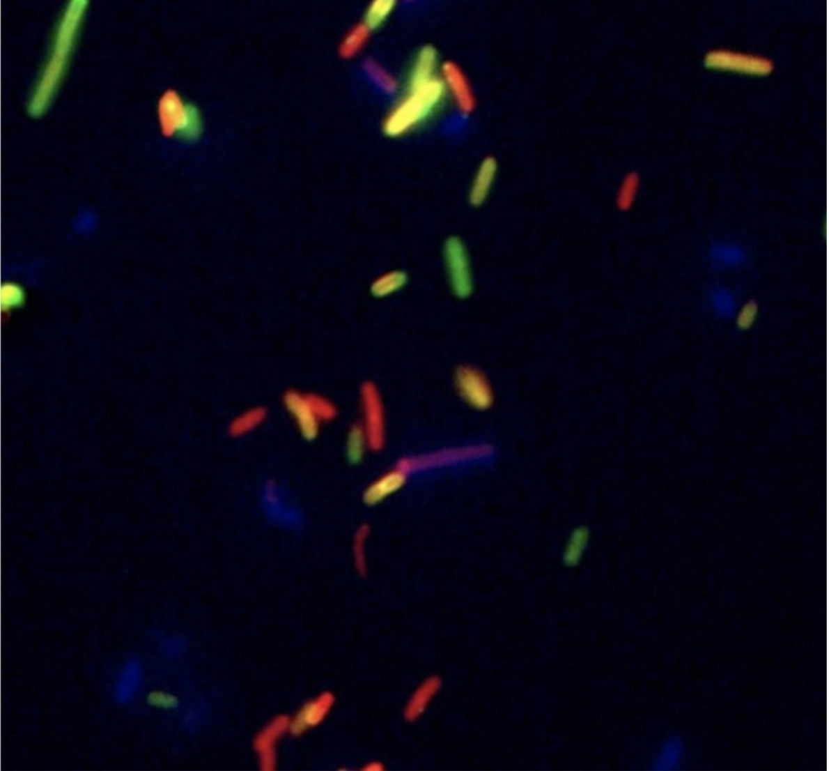
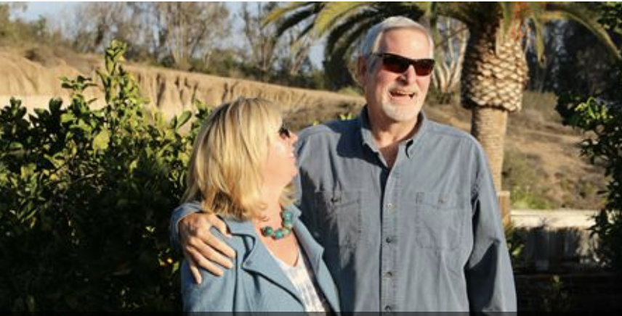
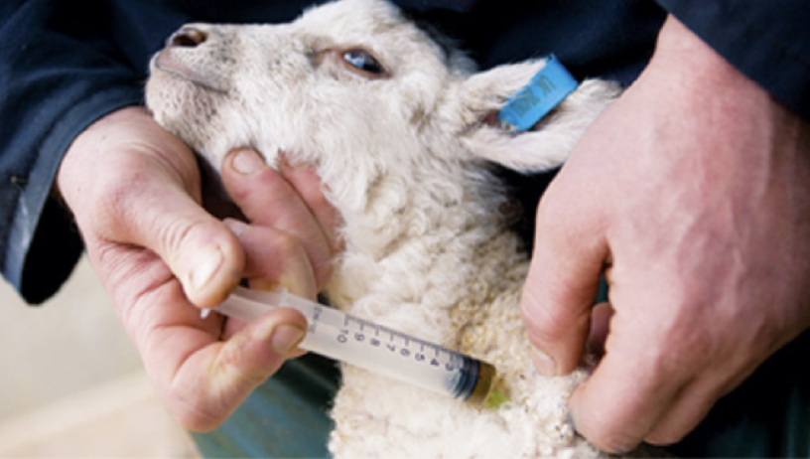
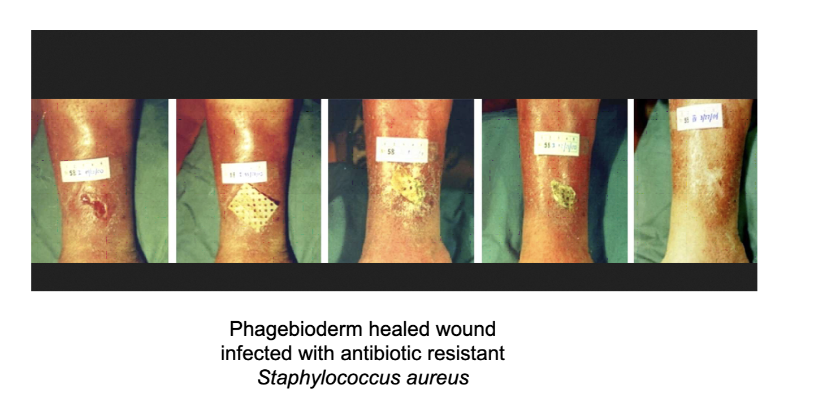
Exciting Phage Applications!

Slide 13
Thank You…
Dr. Fillman
Dr. Guild
Megan Greening
HHMI
Kyla Foster, Galen Squiers, and all of the TAs
Jack Johnson, Sophia Ulmer, and all of the LAs
Elizabeth Lajoie, Fernando Hern, and all of the MCDB 1161 students

Slide 14
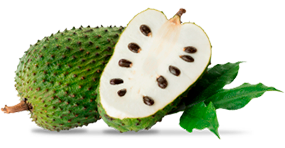
Graviola: a potential chemotherapy in a model of head and neck cancers
Lisa Hansen
The Drug Discovery Lab
Notes:
-Drug Discovery & what we did as a class
-The independent project that my group did with Graviola

Slide 15
Outline:
Cancer and the Discovery Lab
Results from the compound library screen
Highlights from our independent project
Conclusions
Notes:
-preview of where we are going
-discuss the lab
-the testing on a compound library we got from the National Cancer Institute
-touch on my group's independent project
-conclusions and Future directions

Slide 16
Outline:
Cancer and the Discovery Lab
Results from the compound library screen
Highlights from our independent project
Conclusions
Notes:
-cancer
-drug discovery lab

Slide 17
Outline:
Cancer and the Discovery Lab
Results from the compound library screen
Highlights from our independent project
Conclusions
Notes:
-cancer
-drug discovery lab

Slide 18
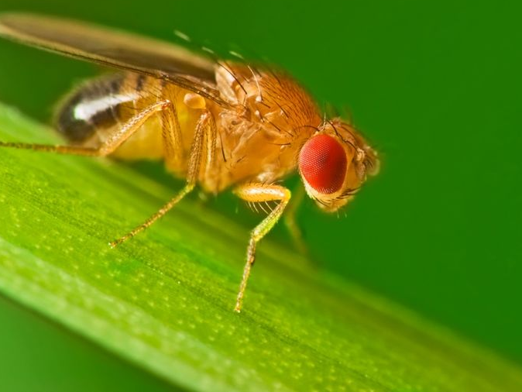
The Drug Discovery Lab
Cancer research and novel chemotherapeutics
Model organism, Drosophila melanogaster
Compound library from the National Cancer Institute
Independent projects
Notes:
-our aims are to
-find novel chemotherapies
-tests them with radiation
-doing this using the model organism Drosophila melanogaster
- which are flies
-we initially used this methodology with a library of compounds that we got from the National institute of cancer
-then we applied that same methodology to independent projects with compounds of our choosing

Slide 19
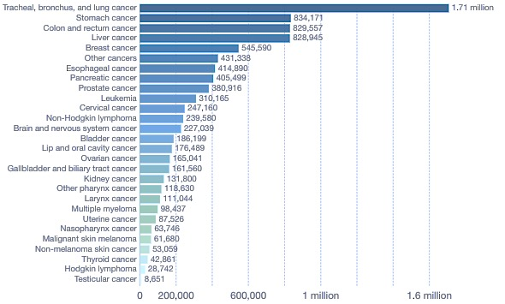
Why cancer?
Notes:
-ultimately what we know is that cancer is bad, AND cancer is complicated, which is why we haven't eliminated it yet
-100s of different diseases in different forms
-all different NO SINGLE CURE
-this is a chart of Cancer deaths by type world wide in 2016
-shows the sheer magnitude of the destruction of this disease

Slide 20
The cancers we are modeling
Notes:
-Our model is focused on head and neck cancers
-bc the mutation in our flies making them sensitive to radiation is similar to the human mutation which is present in head and neck cancers
-GRAPH SHOWS EXAMPLES OF THIS

Slide 21
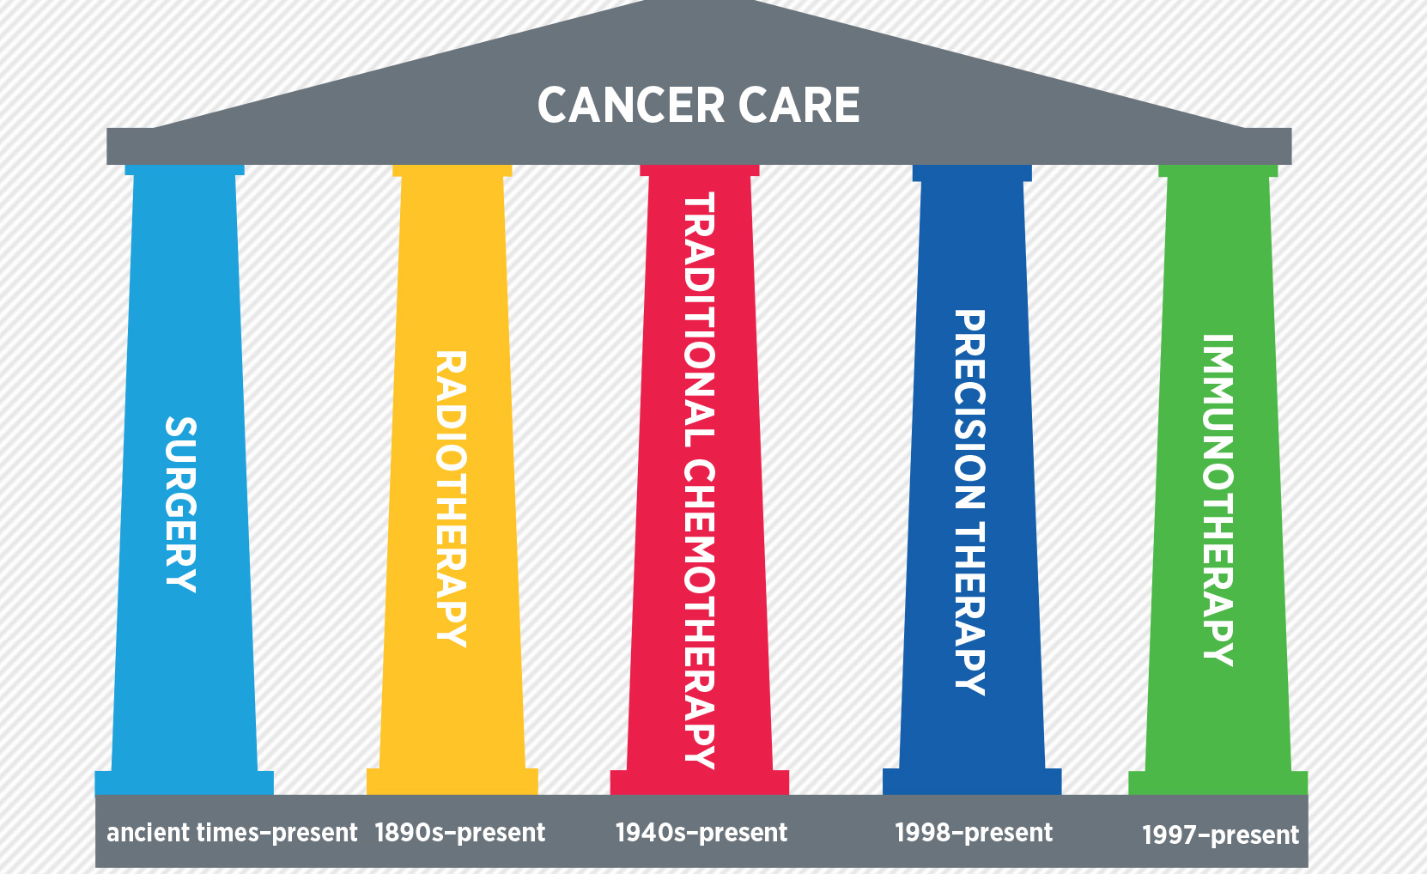
What treatments are available?
Notes:
-5 types of cancer care
surgery, radiotherapy, chemotherapy, precision therapy, immunotherapy

Slide 22
Our focus
Notes:
Though we learned about all 5 in class, out approach is based on the combination of RADIATION THERAPY AND CHEMOTHERAPY

Slide 23
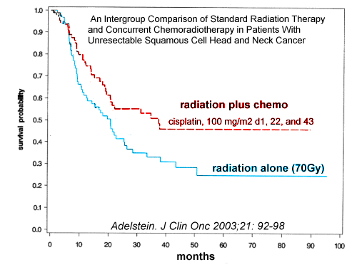
Combinatorial therapy
Notes:
-combinatorial therapy, synergistic, focus of class, better for patient, less toxic
-benefits: more effective (shown by graph-inc survival with combinatorial), lower doses of each, decreasing toxicity and increasing quality of life
-RADIATION-DNA damage, CHEMO- other impacts on cell cycle, damage doesn't get fixed ofter
-when cells are weakened, hit them with another treatment inc effectiveness

Slide 24
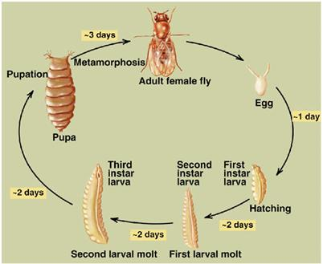
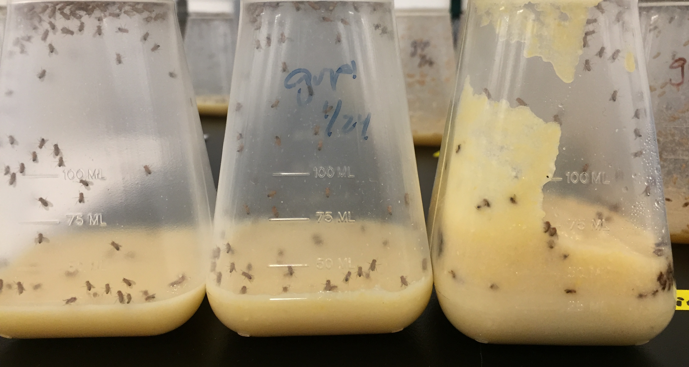
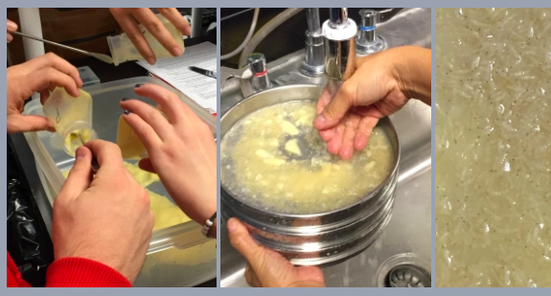
Experimental approach:
Drosophila melanogaster
Notes:
-our method
-Drosophila melanogaster, larvae model for tumor, GOAL IS DEATH
-quick life cycle, whole thing happens in a matter of days
-fairly simple organism
-obstacle= flies much more radioresistant, but we were able to control the genetic makeup of our flied and create mutants that were more sensitive to radiation to create a more realistic model
-used 3rd instar larvae, irradiated them (to kill 50%, 2500RAD) and fed them the compound then quantified survival

Slide 25
Outline:
Cancer and the Discovery Lab
Results from the compound library screen
Highlights from our independent project
Conclusions
Notes:
now that we have discussed the lab and cancer we will move on to the experiments that our entire class conducted

Slide 26
Diversity Set IV – National Cancer Institute
Compound #
Notes:
-we were given compounds that we were blinded to and we irradiated flies, fed them the compounds, then quantified survival
-we are interested in compounds with results more than 2 standard deviations outside of the mean, we are calling these points "hits" 2 SD ABOVE OR BELOW MEAN
-looking at this bottom portion specifically since they had decreased survival

Slide 27
Results of the compound screen
39-5 – NSC63963 – ATRYPTAMIN ACETATE
39-6 – NSC66847 – THALIDOMIDE
40-5 – NSC77596 – 4-CHLORO-5-[2-(1,3-DIOXOLAN-2-YL)ETHYL]-6-METHYLPYRIMIDIN-2-AMINE
40-7 – NSC 79139 – 2-NORBORNANEACETIC ACID
41-1 – NSC89249 – N-[2-HYDROXY-2(4-NITROPHENYL)ETHYL]ACETAMIDE
45-1 – NSC106208 – 3-((O-CHLOROPHENYL)AZO)-2,6-DIAMINOPYRIDINE
Notes:
We ended up with 6 hits (ONLY HITS) that we were confident about
-we were able to identify our negative and positive controls
-see that the irradiated flies were completed wiped out by all of these compounds
-one compound of interest that we identified is thalidomide, compound 39-6

Slide 28
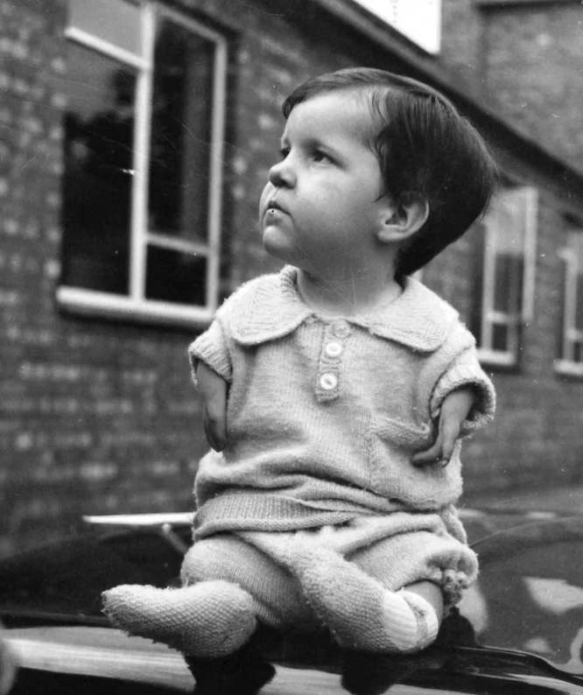
Results of the compound screen
39-5 – NSC63963 – ATRYPTAMIN ACETATE
39-6 – NSC66847 – THALIDOMIDE
40-5 – NSC77596 – 4-CHLORO-5-[2-(1,3-DIOXOLAN-2-YL)ETHYL]-6-METHYLPYRIMIDIN-2-AMINE
40-7 – NSC 79139 – 2-NORBORNANEACETIC ACID
41-1 – NSC89249 – N-[2-HYDROXY-2(4-NITROPHENYL)ETHYL]ACETAMIDE
45-1 – NSC106208 – 3-((O-CHLOROPHENYL)AZO)-2,6-DIAMINOPYRIDINE
Notes:
-thalidomide was a drug which was used in the 1950s and early 60s by pregnant mothers for morning sickness, resulted in limb deformities mostly in Canada, West Germany and Great Britain, the drug was fast tracked and had very superficial testing before approval but was rejected by the FDA
-the toxicity of the drug helps to justify our result as it was toxic enough to kill all of the irradiated flies,-SIMILAR POSSIBLY BC QUICK DIVIDING CELLS IN ARM LIKE QUICK DIVIDING CELLS IN TUMOR?

Slide 29
Outline:
Cancer and the Discovery Lab
Results from the compound library screen
Highlights from our independent project
Conclusions
Notes:
-we've discussed the course and our focus and we've also seen the results from the compound library
-now we will move on to discuss my group's independent project

Slide 30
Independent project - Graviola
Notes:
-Out compound was Graviola, a fruit, (Annona muricate) from tropical portions of Americas and Caibbean which is said to have potential as a chemotherapy
picked because anecdotally there has been documented success, excitement in group, tests with prostate and breast cancers
-dilution using a capsule which is on the market as a dietary supplement
-an extract made from dried leaves and ethanol
-and a dilution of quercetin dihydrate, quercetin is a flavanoid that is in graviola and is an active ingredient that we thought might have potential
-Flavanoid help plants as defense against frost, drought, temperature regulation
-Quercetin( effective for prostate cancer, inhibit invasion migration and signaling through growth factor receptios: all involved in cell survival and proliferation and can induce apoptosis)
-decided to test w and w/o radiation to see it's potential alone vs combined

Slide 31
Independent project - Graviola
Notes:
-here are are the quantified survivals for the radiosensetive flied for both the capsule and the extract, both with 4 dilutions of different concentrations, most to least
-see that radiation killed more than not and when compared to the negative controls the compounds killed more but not as much as positive control
-colchicine is a known chemotherapy that is basically toxic and no longer used, so we are confident that it will kill all or most flied

Slide 32
Independent hit - Quercetin
Notes:
Quercetin, our third test was our "hit" (2sd below mean)
-hit in all concentrations compared to negative control
-more died w radiation than without
-potential that it is more of a poison since it so effectively killed the flies

Slide 33
Conclusions
There is a need for new chemotherapies.
Our approach allows for identification of combinatorial therapies.
Six compounds of interest were identified.
Quercetin, a component of graviola, warrants further investigation as a potential novel chemotherapy.
Notes:
-there is a need for novel chemotherapies because cancer is still so wide spread and devastating
-our method allows for the identification of new combinatorial therapies by coupling radiation with different compounds
-the compounds we found from the drug screen can move on to more testing (Tin Tin)
-Quercetin, from our independent project, also warrants further investigation

Slide 34
Future directions
Determine the dose-response characteristics of quercetin.
Test compounds in human cancer cells.
Using animals, determine toxicities, optimal dosing, metabolism, and pharmacokinetics.
Transfer to a pharmaceutical company?
Notes:
-dosage curve to see if there is a level that is not toxic but theraputic
-test in human cancer cells
-in organism to find pharmacokinetics and more specifics about interactions
-move on to pharmaceutical companies????

Slide 35



Acknowledgements
Dr. Tin Tin Su – Principle investigator
Dr. Pamela Harvey & Dr. Maureen Bjerke
Discovery Lab Teaching Assistants
Funding:
Howard Hughes Medical Institute
Biological Sciences Initiative
Department of Molecular, Cellular, and Developmental Biology
Notes:
Thank you to
START W FUNDING
ByerkE

Slide 36
Questions?

Slide 37
Characterizing rtn3 Expression and Function in Xenopus laevis
Thom Sizemore
MCDB 4100: Editing Genomes with CRISPR

Slide 38
Overview
Why Xenopus?
What is rtn3?
Why are we using CRISPR-Cas9?
What have we discovered so far?

Slide 39
Objectives of MCDB 4100
Primary Objective: Characterize the expression and function of Reticulon 3 in Xenopus laevis.
  1. Design sgRNAs to target rtn3 for mutagenesis or silencing
  2. Design anti-sense RNA probes for use in situ hybridization
  3. Observe X. laevis embryos that have been injected with both sgRNA and Cas9 or dCas9 to characterize phenotypes associated with mutagenesis or silencing of rtn3

Slide 40
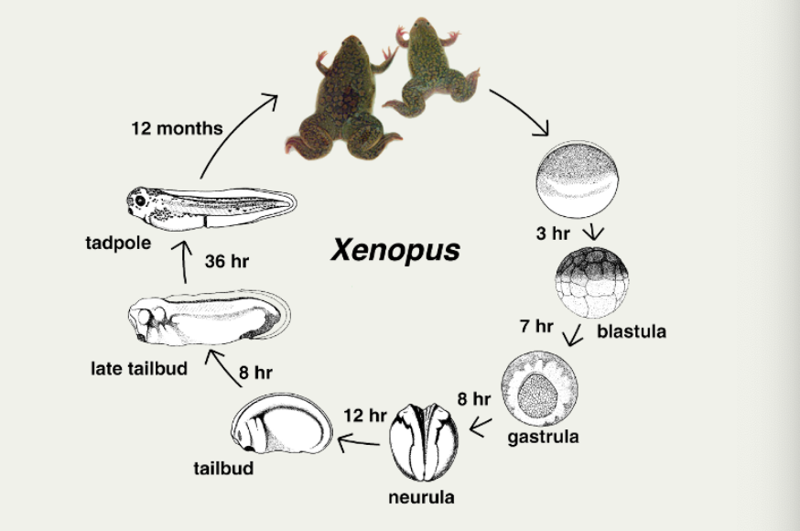
Xenopus laevis as a model organism
African clawed frog
Durable and easy to maintain in lab
  Lay hundreds of large eggs
  Hardy embryos tolerate manipulations
  Embryos develop rapidly externally
Genetic similarity to humans
  Model for human disease
(xenbase.org)
Notes:
-frog eggs can be produced in large quantities→ meaning we can investigate the early period of embryonic development
-rapid development means that within a couple days, a tadpole has fully functional set of organs and can be examined for any experimental effects
-embryos tolerate extensive manipulation (single cell, germ layer dissections, tissue transplantations, injections)
-we can easily to inject into whole embryo

Slide 41
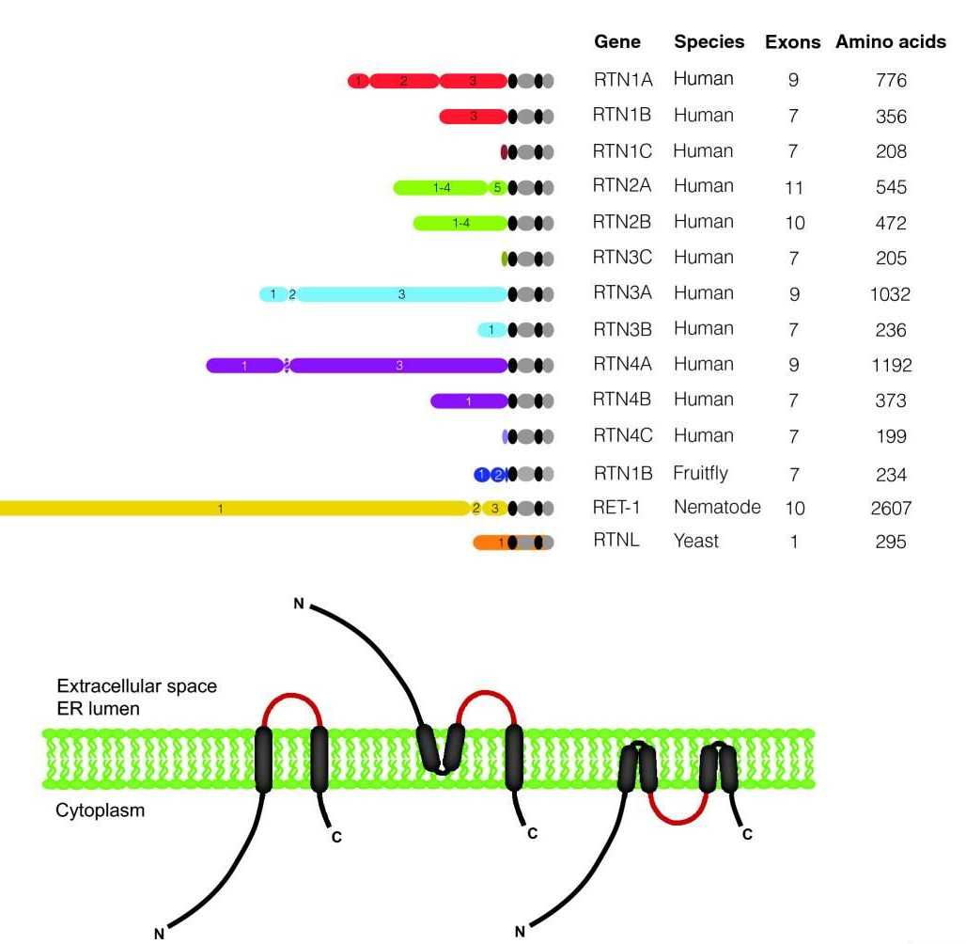
Reticulon 3 (rtn3)
ER membrane protein
Reticulon family
Homo sapiens:
  membrane trafficking
  Inhibits beta-secretase enzyme 1 (BACE1) activity
Alzheimer’s mice models
  Rtn3 deficient mice display increased amyloid plaques
(Yang and Stritmatter, 2007)
Notes:
Reticulon 3 is highly expressed in Xenopus embryos
Associated to ER membrane
Reticulon family has been associated with vesicle formation and trafficking, and ER membrane curvature
RTN3 specifically has been implicated in membrane trafficking and regulation of BACE 1 activity in humans and mice.
MICE:
Reticulon 3 (RTN3) has previously been shown to interact with BACE1 and negatively regulate BACE1 activity.
BACE1 thus is active when rtn3 is deficient which leads to amyloid fiber buildup

Slide 42
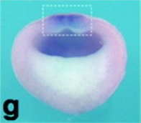
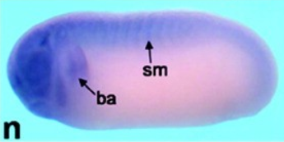
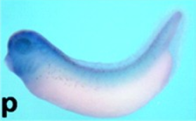
Nervous Tissue Expression in Xenopus laevis
Rtn3 is expressed in the neural plate (g), the somites and branchial arch (n), and the head (p).
( Park et al., 2016)
Preferential expression in neural tissues including ectoderm and mesoderm
The mechanistic connection between rtn3 and neural function is not well characterized.
Notes:
The preferential expression of rtn3 in the neural tissue interests us because it suggests rtn3 may be involved in the formation, migration, or differentiation of neural crest cells which give rise to craniofacial bones

Slide 43
Hypotheses
Published in-situ hybridization assays show staining in neural tissue in later development, because these tissues are derived from the ectoderm, we predict that expression of rtn3 will localize to the ectoderm.
Since rtn3 is expressed in neural tissues, rtn3 will cause neural tissue abnormalities when mutated or silenced.
Notes:
If rtn3 is involved or required for neural crest migration, a knockout could result in massive developmental problems like missing neural tissue due to lack of ER curvature, even a knockdown would likely result in abnormal development

Slide 44
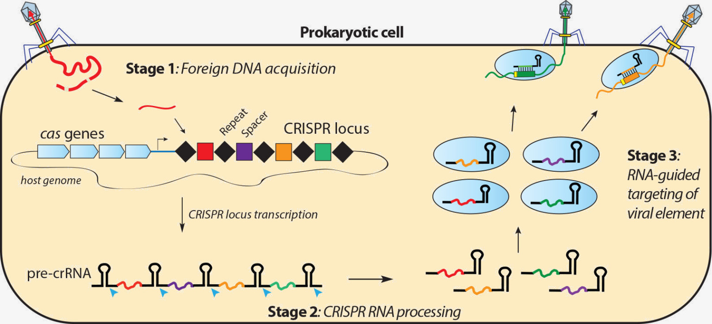
CRISPR-Cas9
Doudna Lab
Notes:
Highly specific mechanism of cleavage. Prokaryotic adaptive immune system viral DNA clippings, when transcribed is attached to a scaffold. This permits later targeting of new infection

Slide 45
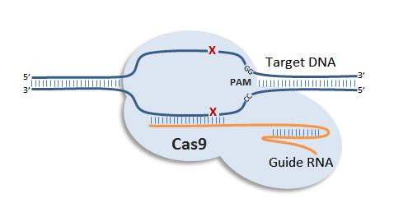
CRISPR-Cas9 Mutagenesis
Requires dsDNA, scaffold, sgRNA, and Cas9 protein
Produces double-stranded break
  leads to non-homologous end joining
  mutation prone repair mechanism
creative-animodel.com

Slide 46
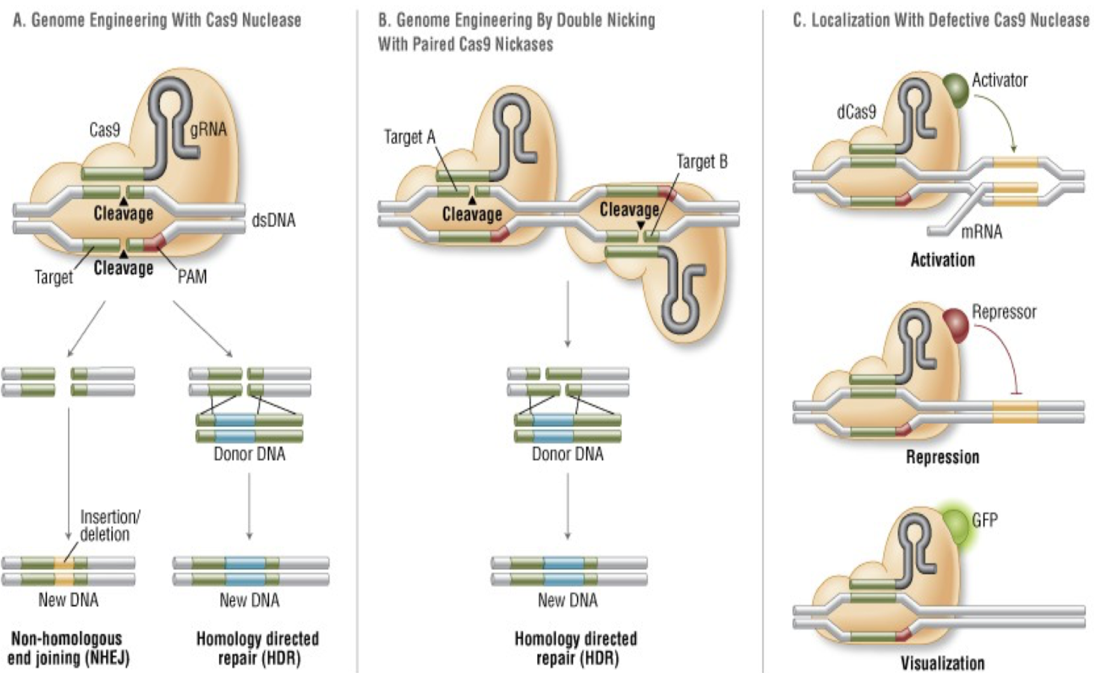
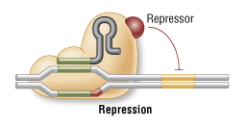
dCas9-KRAB Transcription Inhibition
Chimera KRAB protein and catalytically inactive Cas9
Prevents RNA polymerase from binding to sequence and initiating or elongating transcription
Lecture Slides

Slide 47
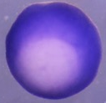
Whole Mount In Situ Hybridization
Shows gene expression at particular moment in time
RNA probes containing DIG-UTP
Compared to known probes

Slide 48
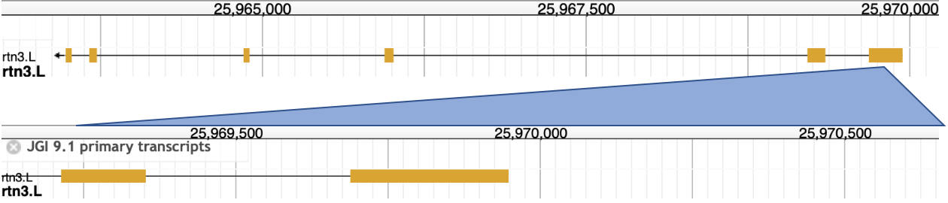
What are we doing?
4 3 2 1
Designed 4 sgRNAs for CRISPR experiments
End of 5’UTR, bridging splice site
Predicted transcription start site
First exon, dual use
End of first exon, bridging splice site

Slide 49
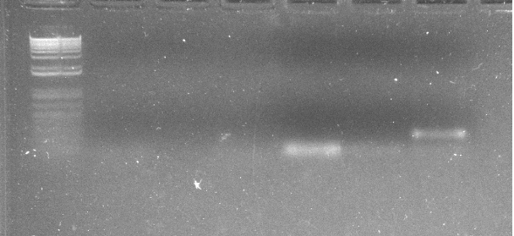
DNA gel electrophoresis for PCR samples to amplify template for in situ hybridization probe show a product at the expected size
Experimental: rtn3 primer
  The specific gene product is expected to be 200-250bp and running under the gel loading dye.
Notes:
We amplified exonic gDNA using designed in situ primers to generate our in situ probe sequence.
We did this successfully

Slide 50
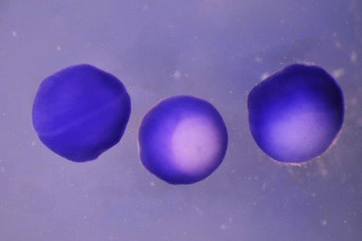
In situ hybridization shows rtn3 expression in the early ectoderm
Moderate expression in ectoderm
Weak expression in mesoderm
No expression in endoderm
Left to right neurula stage embryo, mid-gastrula stage (St. 10.5) embryo or early gastrula (St. 10) embryo.
Notes:
Positive Control: Xbra
Negative Control: sense probe

Slide 51
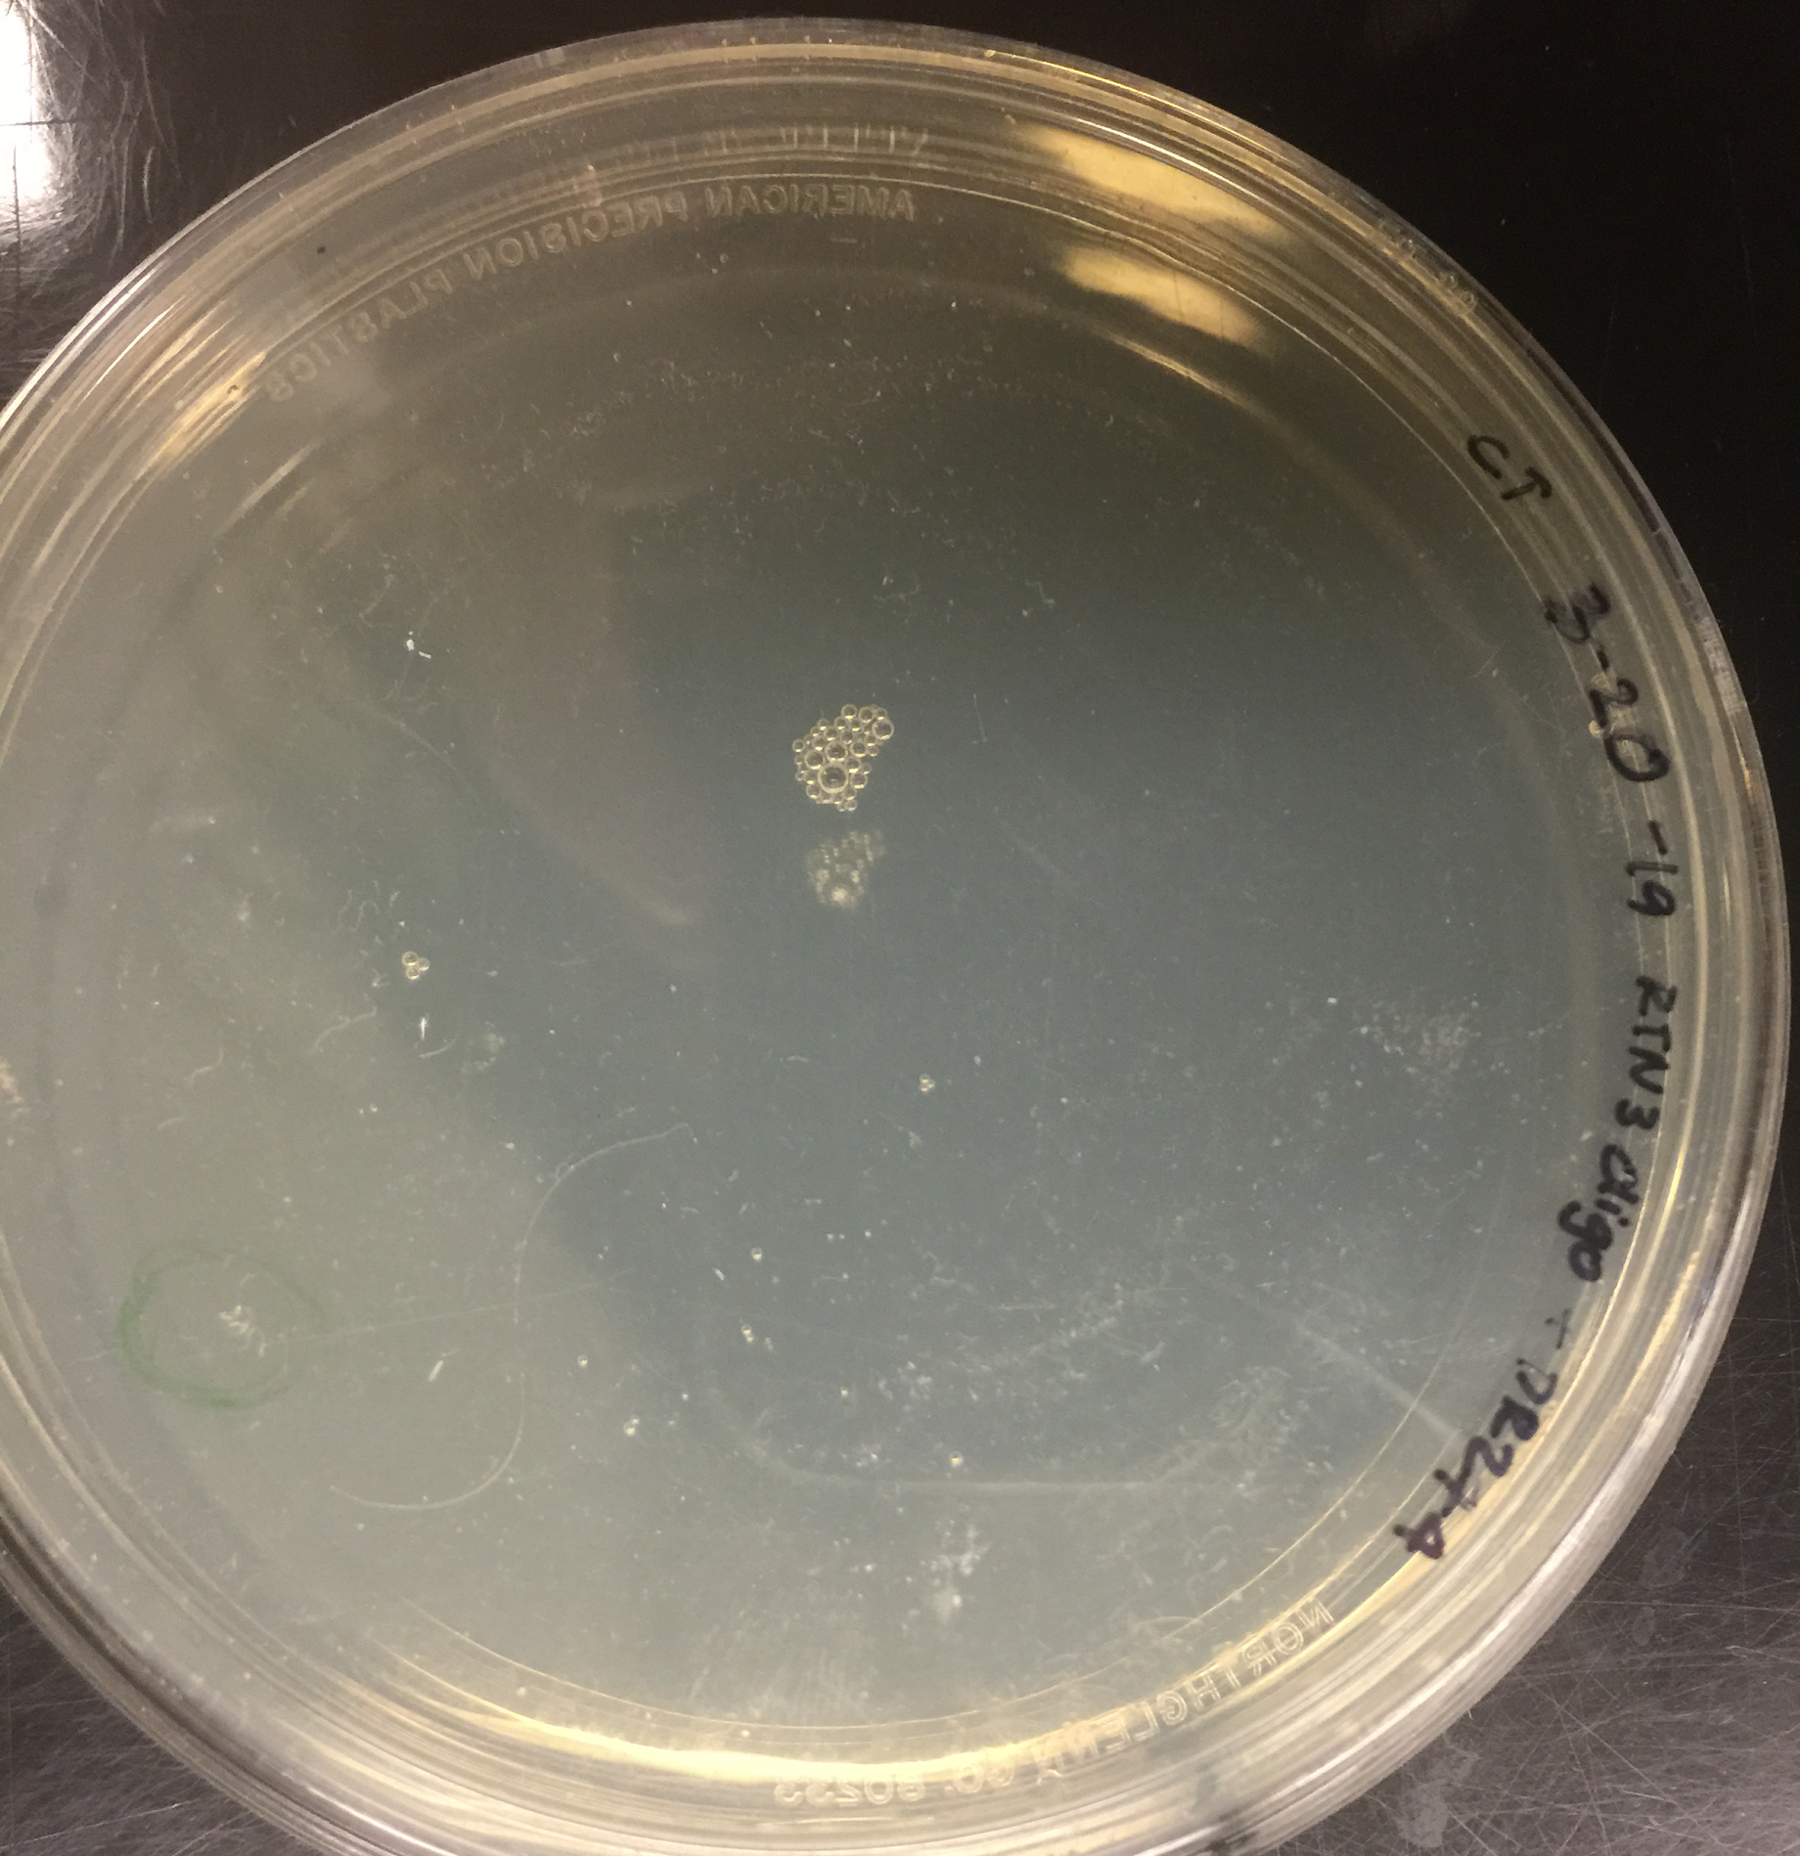
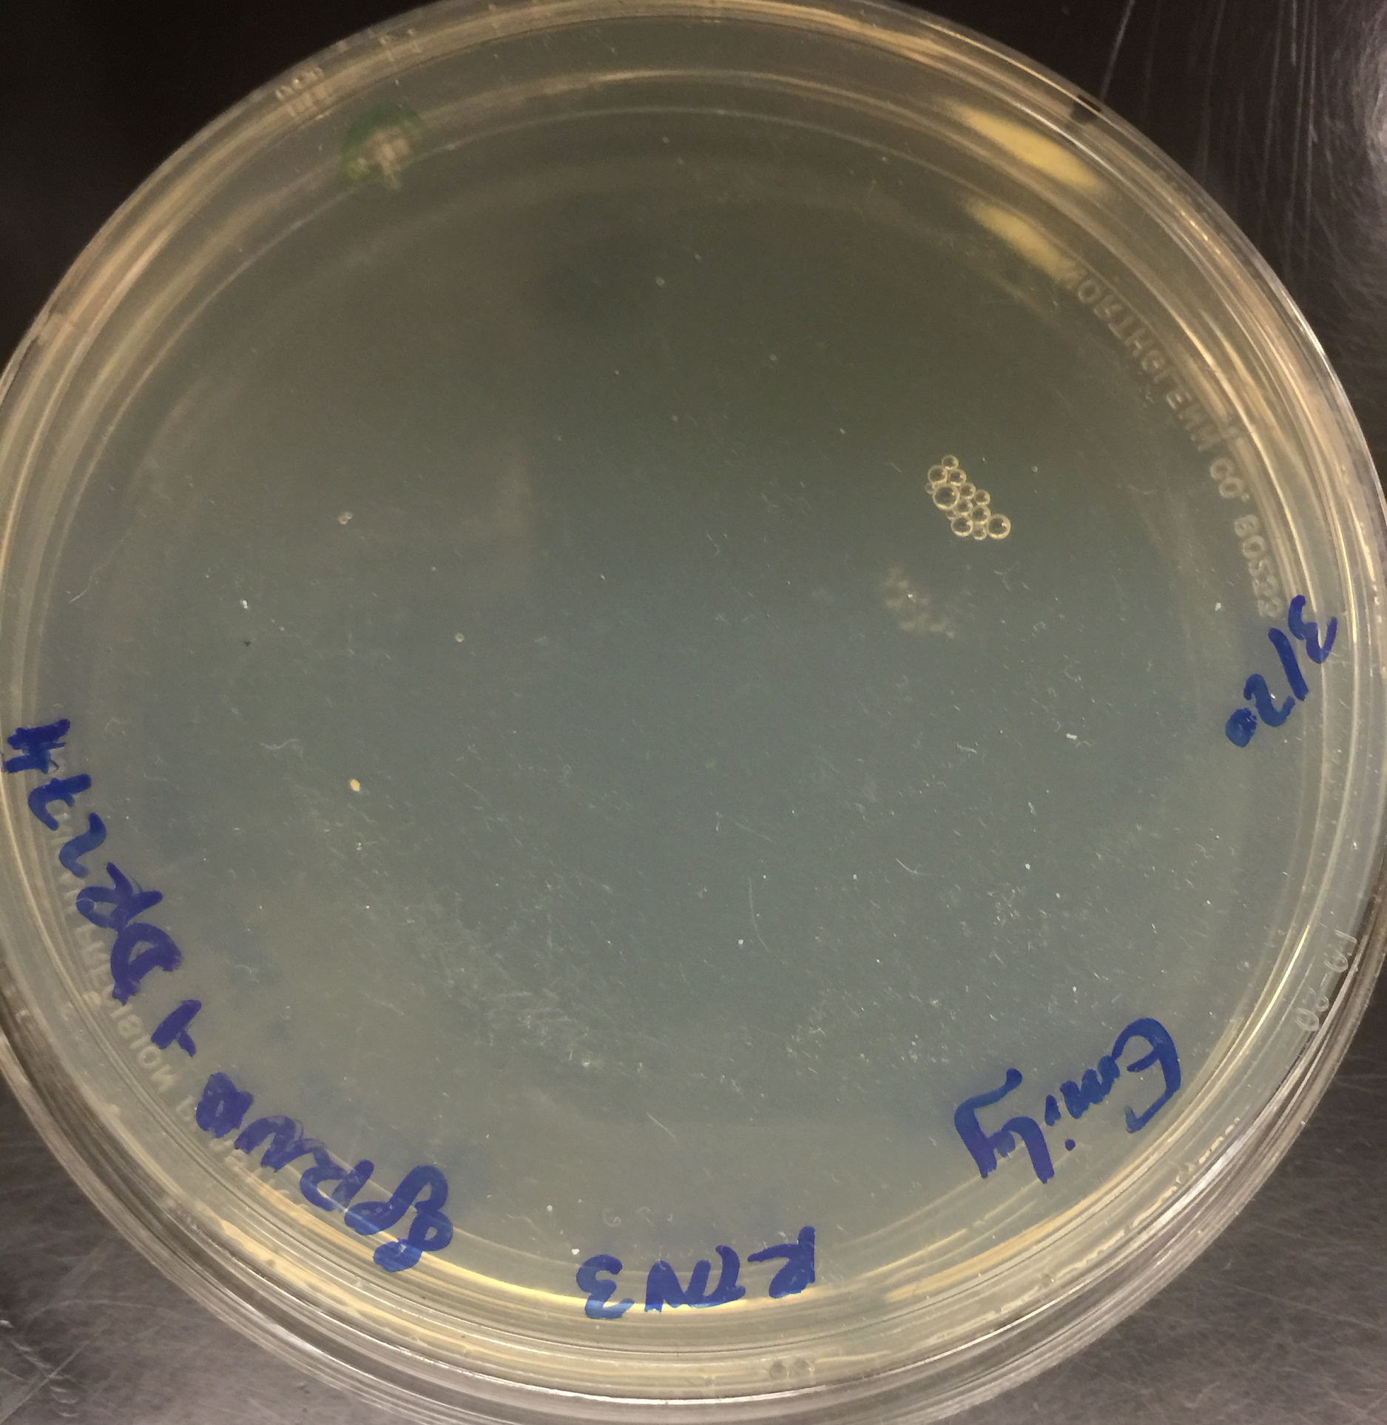

Bacterial transformation and colony selection of E. coli with sgRNA target sequences.
Experimental plates: rtn3 sgRNA+DR274
Notes:
Controlled for self-ligation and protocol errors
not as efficient as expected (1-4 vs 10-15)
classwide problem, not single group

Slide 52

Diagnostic PCR for sgRNA targets show possible positive results
Samples 1 and 2 showed faint bands
Other samples appeared empty
1 2 3 4
+
Notes:
possible that some bacteria were both competent and successfully transformed
not reproduced yet

Slide 53
Conclusions
In situ hybridization probe likely specific to rtn3
  Gene product running around 200-250bp as expected
  Preliminary data showed expression in ectoderm and mesoderm as expected
Bacterial transformation of sgRNAs inefficient
  Few colonies
  Repeat to confirm faint bands seen in gel
Cannot demonstrate validity of predictions
  Lacking results

Slide 54
Future Objectives
Repeat bacterial transformation experiments with increased efficiency
Repeat in situ hybridization at different stages
Complete CRISPR-Cas9 mutagenesis
Complete dCas9-KRAB transcription inhibition experiments
Observe phenotype of embryos with mutated or silenced rtn3
Notes:
New materials
Compare results/observe gene expression
Observe gene function
Focus on nervous tissue

Slide 55

Summary
What makes a good model organism?
  Ease of use and application to your gene of interest
What is Reticulon 3?
  ER membrane protein gene, expressed in developing neural tissue of X. laevis
What are we trying to do?
  Characterize rtn3 expression and function in X. laevis
What have we discovered?
  Designed probe is specific and showed early ectodermal expression
Where do we go from here?
  Complete CRISPR-Cas9 mutagenesis and silencing experiments

Slide 56
Acknowledgements
Thank you to Dr. Tyler Square and Dr. Dan Medeiros for providing the CRISPR-CAS9 protocol and tyrosinase sgRNA and Cas9 mRNA constructs.
Funding for this project was provided in part by CSL 2016 Chancellor’s Award and 2017 UROP Team Grant to Dr. Bilge Birsoy and Dr. Michael Klymkowsky and course fees paid by students.
Thank you to Dr. Bilge Birsoy and Dr. Michael Klymkowsky for their guidance.

Slide 57
References
Hellsten, Uffe et al. “The genome of the Western clawed frog Xenopus tropicalis.” Science (New York, N.Y.) vol. 328,5978 (2010): 633-6.
doi:10.1126/science.1183670
Karimi et al. 2018, Nucleic Acids Research, Volume 46, Issue D1, pp. D861-D868,
doi:10.1093/nar/gkx936
Park, E. C., Shim, S. and Han, J. (2005), Identification and expression of XRTN2 and XRTN3
during Xenopus development. Dev. Dyn., 233: 240-247. doi:10.1002/dvdy.20327
Sharoar, M. & Yan, R. (2016). Effects of altered RTN3 expression on BACE1 activity and
Alzheimer’s neuritic plaques. Reviews in the Neurosciences, 28(2), pp. 145-154.
Retrieved 12 Apr. 2019, from doi:10.1515/revneuro-2016-0054
Sharoar, M. G., Shi, Q., Ge, Y., He, W., Hu, X., Perry, G., … Yan, R. (2016). Dysfunctional tubular
endoplasmic reticulum constitutes a pathological feature of Alzheimer’s disease.
Molecular Psychiatry, 21(9), 1263–1271. https://doi.org/10.1038/mp.2015.181
Shi, Q., Ge, Y., Sharoar, M. G., He, W., Xiang, R., Zhang, Z., … Yan, R. (2014). Impact of RTN3
Deficiency on Expression of BACE1 and Amyloid Deposition. Journal of Neuroscience,
34(42), 13954–13962. https://doi.org/10.1523/JNEUROSCI.1588-14.2014
http://www.xenbase.org/gene/showgene.do?method=display&geneId=975125
Yang, Yvonne S., and Stephen M. Strittmatter. “The Reticulons: A Family of Proteins with Diverse Functions.” Genome Biology, vol. 8,
no. 12, Dec. 2007, p. 234. BioMed Central, doi:10.1186/gb-2007-8-12-234.

Slide 58

Analysis of Gene Expression in the Burmese Python Liver
Helen Bassett
CURE Symposium
April 24, 2019

Slide 59

Overview
Part I.
The Burmese python
Metabolic syndrome
Scd-1
Part II.
Experimental hypothesis
Methods
Results
Conclusions
Acknowledgements

Slide 60

The Burmese Python
Notes:
Subtropical rainforests are preferred, although this snake is adaptable to a wide range of habitats including swamps and marshes, grasslands and the rocky foothills of their native land.

Slide 61

The Burmese Python
Florida

Slide 62


The Burmese Python
Python bivittatus
Grow up to 8 meters (26 ft), weigh up to 91 kg (200 lbs)

Slide 63
The Burmese Python
Python bivittatus
Grow up to 8 meters (26 ft), weigh up to 91 kg (200 lbs)
Opportunistic hunters
Eat up to 1.5x its body weight

Slide 64


Why Study the Python?
Extreme model of:
  Cholesterol homeostasis
  Organ growth
  Lipid processing
C. Riquelme and S. Secor, Modified
L. Leinwand
Notes:
Involved with cancer, heart disease, obesity, and even neurodegenerative disorders such as Alzheimer’s

Slide 65

Metabolic Syndrome
The combination of conditions that often lead to cardiovascular disease, type II diabetes, stroke, and cancer
DF Blog
Notes:
U.S. top 10 causes of death

Slide 66

Metabolic Syndrome
The combination of conditions that often lead to cardiovascular disease, type II diabetes, stroke, and cancer
Large-scale problem

Slide 67
Metabolic Syndrome
The combination of conditions that often lead to cardiovascular disease, type II diabetes, stroke, and cancer
Large-scale problem
Reduces life expectancy up to 5 years

Slide 68

Stearoyl-CoA desaturase 1 (Scd-1)
Endoplasmic reticulum enzyme
  Hepatocytes and adipocytes
Notes:
Kinks substrate into position for double bond catalysis
Often acts as dimer, thought to be a measure of regulation
4 transmembrane domains
Long thin hydrophobic substrate binding site

Slide 69
Stearoyl-CoA desaturase 1 (Scd-1)
Endoplasmic reticulum enzyme
  Hepatocytes and adipocytes
Catalyzes the rate-limiting step in the formation of monounsaturated fatty acids (MUFAs)
Notes:
Kinks substrate into position for double bond catalysis
Often acts as dimer, thought to be a measure of regulation
4 transmembrane domains
Long thin hydrophobic substrate binding site

Slide 70
Stearoyl-CoA desaturase 1 (Scd-1)
Endoplasmic reticulum enzyme
  Hepatocytes and adipocytes
Catalyzes the rate-limiting step in the formation of monounsaturated fatty acids (MUFAs)
  MUFA products involved in membrane fluidity and stored as fat
Notes:
Purple is the ER membrane, on top is cytosol, on bottom is lumen
Kinks substrate into position for double bond catalysis
Often acts as dimer, thought to be a measure of regulation
4 transmembrane domains
Long thin hydrophobic substrate binding site

Slide 71

Scd-1’s role in MUFA synthesis
Scd-1
Zhang, Z., Winther, M. D. Journal of Medicinal Chemistry
Notes:
A series of redox reactions allows Scd-1 to use electrons from cytochrome b5 as well as molecular oxygen to catalyze the new double bond formation specifically between carbons 9 and 10 on the fatty acid chain
NADH to Cytochrome b5 flavoprotein to cyt b5
Uses oxygen and electrons from reduced Cb5 to introduce the double bond
Stearic acid is a common saturated fatty acid
Oleic acid common monounsaturated omega-9 fatty acid
Cytochrome b5 is an electron transfer oxygen-binding protein
Cb5 reductase (flavoprotein) carries a redox reaction to Cb5
Electron flow and molecular oxygen introduces double bond
Wax esters are an ester of fa and alcohol..make things like beeswax
SCD1 expression is known to be stimulated under adipogenic conditions through a variety of transcription factors, notably SREBP1 and C/EBPα and −β.

Slide 72


Scd-1’s involvement in diseases
Research indicates correspondence to obesity, high triglyceride plasma levels, atherosclerosis, insulin resistance
  Scd-1 knock out ➔ very low VLDL and LDL levels
Attie, A.D. et. Al. Journal of Lipid Research
Notes:
This is thought to influence insulin sensitivity in diabetics, correspond with obesity, high triglyceride levels in plasma, atherosclerosis
Graph on left compares fatty acid oxidation levels lean and obese people
Graphs compare desaturation levels of fatty acids between lean and obese people—in other words, how many saturated fatty acids are being desaturated
Used plasma ratio of 18:1 to 18:0 as desaturation index
Scd1 ko suggests scd1 activity affects VLDL production rate

Slide 73
Overview
Part I.
The Burmese python
Metabolic syndrome
Scd-1
Part II.
Experimental hypothesis
Methods
Results
Conclusions
Acknowledgements

Slide 74
Predicted Outcomes

Slide 75
Experimental Methods
Design Gene-Specific Primers
Standard Curve Production Using Protein Assay
Isolate RNA
In silico validation
Synthesize cDNA
Conventional PCR
Standard Curve Production Using qPCR
Perform qPCR
Evaluate PCR Product Using Gel Electrophoresis
Analyze and Present Data
Notes:
Throughout the semester, our research was divided into three parts. In the first part, gene-specific primers were designed and validated through different methods.
In the second part, we strengthened skills that would help lead to the best results by producing standard curves.
Finally, we isolated RNA from python liver samples taken during a fast, 1dpf, 3dpf, and 10dpf. These RNA samples would later be used to measure any changes in expression of our gene of interest.

Slide 76

Results

Slide 77

Future Directions
Analyze python serum lipid content in Scd-1 knockout pythons
Examine Scd-1 expression in pythons fed high carbohydrate and high fat diets
Scd-1 gene expression profile in humans

Slide 78
Other notable results
Other genes that were notable:
  Cyp7a1 (Rachel Saggau)
  Fxr1 (Alexis Montague)
  Abca1 (Austin Kemp)

Slide 79
Conclusions
The Burmese python is a suitable model organism
Metabolic syndrome is a large-scale problem
Scd-1 catalyzes the rate-limiting step of MUFA synthesis
Scd-1 was expressed highest 1dpf

Slide 80
Acknowledgements
Thank you to our sponsors!
Dr. Leslie Leinwand and Lab Members
Python Project Alumni Donors
Department of Molecular, Cellular, and Developmental Biology
Notes:
Things to know: Scd has 4 known isoforms in mice, 2 in humans. Scd-1 is supposed to be expressed in hepatocytes and adipocytes, but future experiments would confirm this in the python. Scd-2 is expressed in the brain tissue

Slide 81

Questions?
Notes:
Things to know: Scd has 4 known isoforms in mice, 2 in humans. Scd-1 is supposed to be expressed in hepatocytes and adipocytes, but future experiments would confirm this in the python. Scd-2 is expressed in the brain tissue
Affinity chromatography fusion protein and western blot

